Slide 1
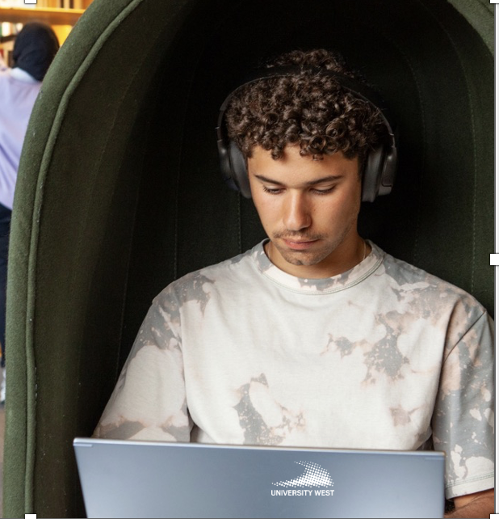
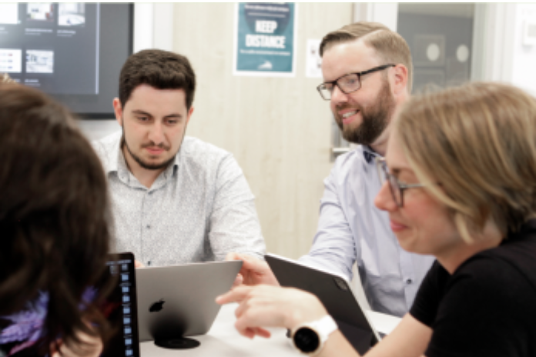

VIP4WIL students in the research project:
“Lead Hybrid”
Leadership and Co-Workership in Hybrid Industries
About the project:
The rise of Industry 4.0 technologies is transforming industrial practices, leading to new organizational approaches in production and innovation. With the shift to Industry 5.0, there is a focus from technology-driven values to human-centered perspectives. This change calls for redefining leadership, co-workership, expertise, and co-creation within a hybrid industry. The COVID-19 pandemic accelerated the adoption of hybrid workplaces, creating new organizational interfaces. The LeadHybrid project will study and collaborate with Bosch Rexroth and Ericsson to explore how leadership and co-workership are evolving to manage dynamic capabilities and expertise in this hybrid environment.
Work tasks:
Conduct literature studies on hybrid workspaces and hybrid leadership
Design a suvery about hybrid workspaces and hybrid leadership
Map links, policys, guidelines on hybrid work regulations
Contribute to data analysis and report writing
Contact:
Ulrika.snis@hv.se, Professor in Informatics and Work-integrated learning
Read more about the research project Lead Hybrid:
https://www.hv.se/en/research/research-projects/primus-forskningsprojekt/leadhybrid---leadership-and-co-workership-in-hybrid-industries/?sq=lead+hybrid

