Slide 1
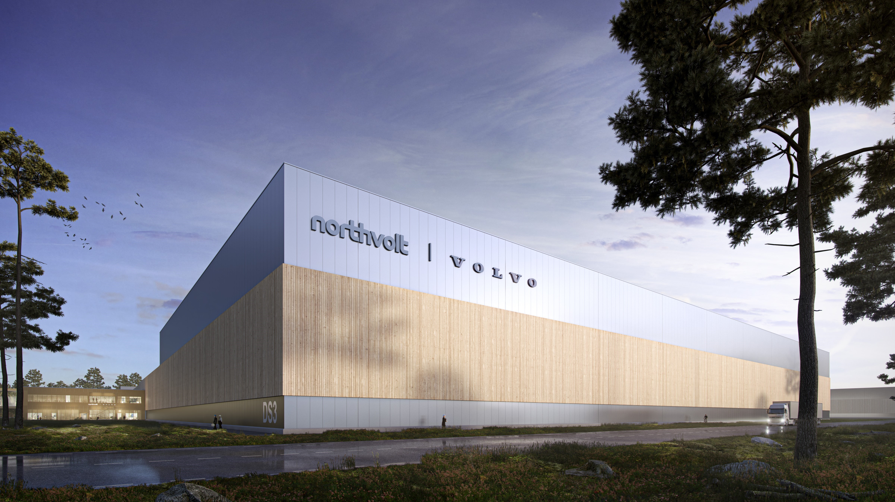

VIP4WIL students in the research project:
Green Transition:
Restructuring, matching, and re-skilling – Public actors and institutions shaping the labour market for green transition in West Sweden
About the project:
For sectors faced with new conditions related to the green transition, the need for a supply of appropriate competences, and as well functioning systems of skill-formation, will be of continuous concern, not only for the industry, but also for the surrounding institutional field of municipal, educational and labour market actors. The purpose of the project is to study the public regional and local actors involved in education, competence development, and re-skilling to understand how they shape the institutional field during a process of green transition in the automotive industry.
The study will focus on the following research questions:
• Who are the main actors in the field and what do they do?
• How do actors in the field shape institutional conditions for competence development, learning and re-skilling in relation to green transition in West Sweden?
• What challenges, possibilities and dilemmas are actors confronting? What influence does the current institutional system have on their strategies, measures, and goals?
• What are the outcomes of the actors’ institutional work in relation to the regions’ ability to improve competence development and re-skilling?
Assignment 1
The field of green transition of the automotive industry in West Sweden includes educational actors of various kinds: from the municipal school-system and the national university system with its regionally placed universities to non-profit organisations and private companies. A second set of actors are the municipal actors, and the myriad coordinating and collaborative actors in charge of organizing for regional development in the form of competence development and matching in the labour market. A third set of actors are labour market actors, such as Job Security Councils and the Swedish Public Employment Agency (PES). Here, there are also a number of temporary organisations and project that, in various ways, are engaged in matching, up-skilling, and re-skilling activities. A fourth set of actors are the automotive industry and the surrounding ecosystem of suppliers, actors that will be covered mainly by the studies in WP1.
As an intern, you will be part of the research group, with the initial role of develop a field overview of the reginal ecosystem of actors involved in supply of appropriate competences and skill in the region
Assignment 2
Conceptually, the focus on institutional work (Lawrence and Suddaby 2006; Lawrence, Suddaby and Leca 2011; Norbäck, 2019) provides us with access to the constitutive and formative process of how something may, or may not, become created, maintained, or disrupted, and hence become institutionalized, and what actors do during this process. The framework of institutional work is useful to understand the recursive relationship between institutions and actions; in effect, how institutions affect action at the same time as action affects institutions. From this perspective, institutional change happens not only because of external chocks, such as disruptive technologies or climate change, but is also influenced by what actors in the institutional field do, and the practices they are engaged in in order to maintain or disrupt the current institutional order in the field (Zietsma and Lawrence, 2010).
As an intern, you will be part of the research group, with the initial role of doing a literature review on the contemporary research Institutional work.
Contact:
Lars.walter@hv.se Professor in Industrial Work-integrated learning

