Slide 1
Academic Studies in Sweden
Rebecka Sverker
Astrid Olsson
Librarians at University West

Slide 2
What is it like to study in Sweden?
Non-authoritarian classroom
Independent study time
Group work
Digital education in Zoom
Notes:
Rebecka

Slide 3
Critical thinking skills?
When to use the critical thinking skills?

Slide 4
Writing assignments?
Plagiarism
Urkund
Copyright
Notes:
Astrid Plagiarism: Plagiarism means the use of another person’s text without making any reference to such use. The source of plagiarised material can be books, articles, the Internet etc. The demand for referencing even extends to material of which the student is themselves the author. Plagiarism is a form of cheating. How do I avoid plagiarism? To avoid plagiarism, you must learn to correctly acknowledge others’ work. You plagiarize if you submit someone else’s work as your own.
You plagiarize if you only replace a few words with synonyms.
You plagiarize if you keep characteristic words or phrases from the original work without marking it as a quote.
You plagiarize if you make a direct translation from another language without adding a ‘my translation’-comment. You plagiarize if you, without referring to the source. You must also contribute with your own comments and reflections!
Urkund – Everything you upload is checked through the URKUND system, to see whether your text is an original text, or has copied bits of text without a reference.
Check your text yourself before handing in! And remember cheaters deceive themselves- they don’t learn!
Some things you need to know!
University West use a system called Urkund which is connected to the Internet, different publishers and other universities around the world. It is used to find texts which are already “published” in other works such as exams, thesis, books, articles and so on.
What is plagiarism? Plagiarism is when you take ideas or sentences from another work and pretend that they are you own words.
You have to find your own words to describe the authors thoughts and ideas.
Try to find synonyms and build your own new sentence/s.
If you can not describe the reference with your own words, you can paraphrase some sentences with quotation marks. But this depends on which reference system you are using.
By using APA you have to make an indent for the text passage you want to refer to. In this case you can use exactly the authors words, in just the same way as they are presented in the book, thesis and so on.
If you want to reuse some sentence from your earlier, own texts, you have to cite your self. Otherwise it could be self-plagiarizing!
Citing means acknowledging the source when you are using it in the main part of your writing.
Referencing means giving the full reference at the end.
A bibliography is a full list of everything you have read on a topic, whether you have cited it or not. It is rare to be asked to give a bibliography.
And, please have in mind: to write a text with your own words will show your teacher/supervisor how well you understand the subject.
If you want to know more about avoiding plagiarism, here are some videos you can check out: https://www.youtube.com/watch?v=PzZsButRaHs ; https://www.youtube.com/watch?v=9Y0MiNc7PK8
Grade system: Godkänd – Underkänd (Pass – Fail) Väl godkänd – Godkänd – Underkänd (Pass with Distinction – Pass – Fail)

Slide 5
What is plagiarism?
Plagiarism is when you take ideas or sentences from another work and pretend that they are you own words.
You have to find your own words to describe the authors thoughts and ideas.
Try to find synonyms and build your own new sentence/s.
If you can not describe the reference with your own words, you can paraphrase some sentences with quotation marks “bla bla“. But this depends on which reference system you are using.
If you want to reuse some sentence from your earlier, own texts, you have to cite your self. Otherwise it could be self-plagiarism.
Citing means acknowledging the source when you are using it in the main part of your writing.
Referencing means giving the full reference at the end.

Slide 6
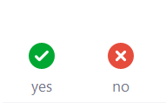
Now follow two questions about plagiarism
Please click on the arrow beside Participants in the meny bar below and click on yes or no depending on your answer

Slide 7
Let’s try it ourselves!
I write verbatim and replace a few words with synonyms and indicate the source. Is it okey? Click on either:
No. You must reproduce the content in your own words.

Slide 8
Let’s try it ourselves!
.
I have been a student at another university and reuse previous text passages from my texts. That's okay, right? Click on either:
Yes or
No, it is not allowed to reuse own previously examined work without referencing, so-called self-plagiarism.

Slide 9
What is Urkund?
University West use a system called Urkund which is connected to the Internet, different publishers and other universities around the world.
It is used to find texts which are already “published” in other works such as exams, thesis, books, articles and so on.
Please have in mind: to write a text with your own words will show your teacher how well you understand the subject.
Check your text yourself before handing in
And remember:
Cheaters deceive themselves - they don’t learn!

Slide 10
Copyright
COPYING TEXTS FOR PRIVATE USE
You may not copy the entire content of a book or journal, but for private use it is permitted to copy:
a limited section, such as a chapter in a book (15% or 15 pages from a book)
a journal article – can be printed out as a whole
E-books – depending on the publisher allows how much
More information on the library’s website

Slide 11
Questions about referencing?
A library guide called Referencing
https://hv.se.libguides.com/c.php?g=243063&p=1616900
APA 7 (American Psychology Association)
Harvard
IEEE (redirecting to Chalmers)
Shortcuts in collecting reference information, etc.
Bring your questions to Language Resource Centre!
Notes:
tryckta böcker
e-böcker
vetenskapliga artiklar

Slide 12
bibliotek.hv.se/en
Görs om till engelsk variant: poängtera GS, DiVA, databaser, e-böcker, ordböcker

Slide 13
Using the library
Computers
Coffee and conversation possible
Group rooms to book
Different study spaces and seating opportunities
Quieter places- silent room

Slide 14
Literature tips!
Academic studies in Sweden : effective study skills and habits, Bergman, M.
Critical thinking : a student's introduction, Bassham, G., 2013
Get started in Swedish, Holmqvist, I., 2013
Success with your education research project, Sharp, J., 2017 (e-book, chapter 10: Writing up)
Course literature, and some fiction

Slide 15
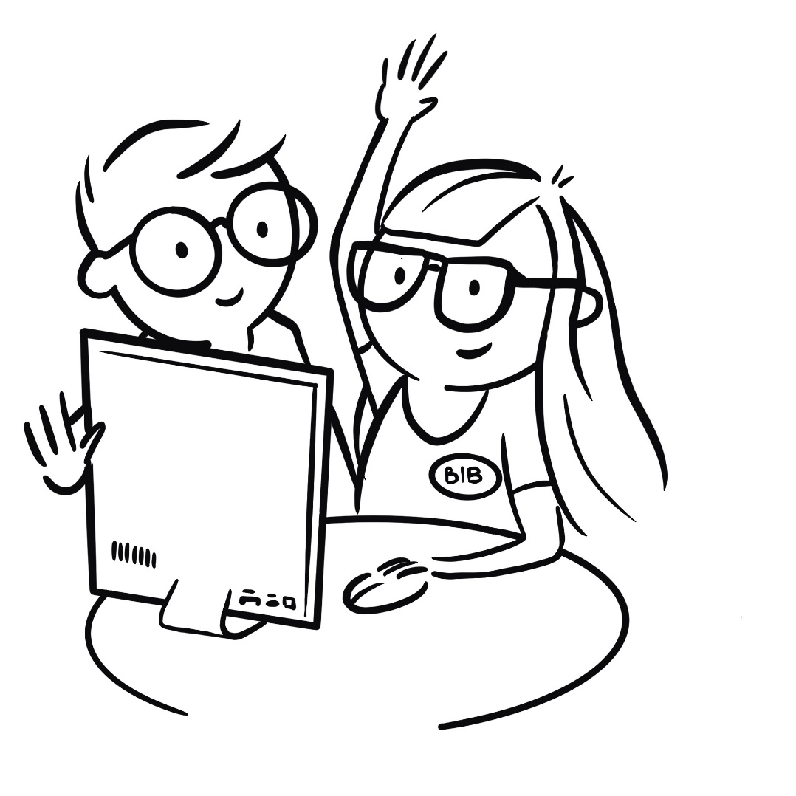
Ask us at the library
About referencing
Information search techniques
To find the language resource centre and math help centre
Chat, zoom, mail, opening hours
bibliotek.hv.se/en
Don’t hesitate

Slide 16
Fika with the library
Friday, October 16, 2.15 PM (outside the library)
Det här fotot av Okänd författare är licensierat enligt CC BY-SA.

Slide 17
Thank you for listening and good luck with your studies!
Contact:
0520-22 34 10​
bibliotek@hv.se
rebecka.sverker@hv.se
astrid.olsson@hv.se

Slide 18
Nice to meet you again….
Fika with the library
Book individual guidance
Informations seeking in the classroom/zoom

Slide 19
Idéer
FUNKA, Tortalk och andra program
Spellright,Rex…
Plagiat- läsa text- fundera över korrekt refering REFERO?
Fika with the library, October 16, 2.15 PM
Language café? André
Part time job? Food delivery jobs in Gothenburg
SI- library host?
Student union- get involved, ask for help
FUNKA-
Study and carrier counsellors

Slide 20
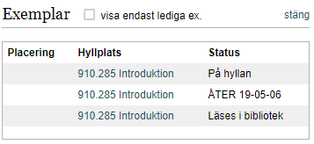
Om boken är utlånad
Först till kvarn
Reservera utlånade böcker
Läses i bibliotek= referensexemplar
Notes:
Till manus: Hur hittar jag boken på hyllan? Siffersystem, internationellt, hyllgavlar, siffra för siffra, sedan alfabetiskt på ordet efter sifferkoden,

Slide 21
Hur skriver jag ut?
Västkort, 50 kr
Multifunction, överallt i huset
Molnet, 8 timmar
Fyll på via paypal.hv.se
Kopiera och scanna
Följ instruktioner
Fråga gärna

Slide 22
Kan jag sätta mig vid en dator och jobba?
Logga in
Obokat
Lämna en kvart
Onedrive eller H: för att spara / nå hemifrån
Datasalarna 7-22.30

