Slide 1
IO1 – Awareness raising to VET providers and fabrication industry
University West

Slide 2
Block 1- Company ID
 | Company A | Company B | Company C | Company D | Company E | Company F
Employee | 850 (Sweden) 90K (Worldwide) | 850 and 3000 salespersons | 65 (Sweden) | 1700 (Sweden) 18 K (Worldwide) | 25K (Sweden) Ca.41K (Worldwide).
Turnover | 0.6 % | 2 403 867 KSEK | 130M SEK | £2.8bn | MSEK 262,833
Welding staff Gender ratio | 30 85/15 % | 14 100% | 14 50 % each | 200 18% for women | 20 worldwide dealing with joining | 9 employees one female
Age distribution | 15 >50, 5 = (25-35) | Middle age | 25-40 years |  | Average above 50 years old | 35 -60; average 50,
Type of Production | High flexibility and low scale | Serial production | Both serial and small scale | Serial | Serial and large series; they also have batch | Serial Production Small scale production
AQL | Defined | Defined | ‘Fadder’ system | Defined | Own VCS standards | No general document Specific for different products
Cost of non-quality | Quite a lot | Special courses to reduce cost | 3 levels; system, process, product | non-conformances are seen as waste | Very costly Process control to avoid | Not sure as it is not related to R&D
Qualification & employment | License to confirm qualification | High or tailored education | Technical educated | Specific qualification and specific processes | People with experience in materials e.g IWE/IWT | IWE certificates, more of metallurgy
VET partner | Gymnasium Engineering - Luleå | Universities & Gymnasium | Institutions & Gymnasium | Owned Aerogymnasiet. | Swerim | Not sure

Slide 3
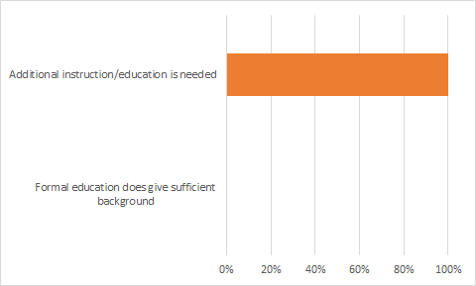
Block 2- Current status, starting point
How companies deal with training now? Focusing on welding-AM/inspection-quality area.
Does the formal education give sufficient background for carrying out the work in the company?

Slide 4
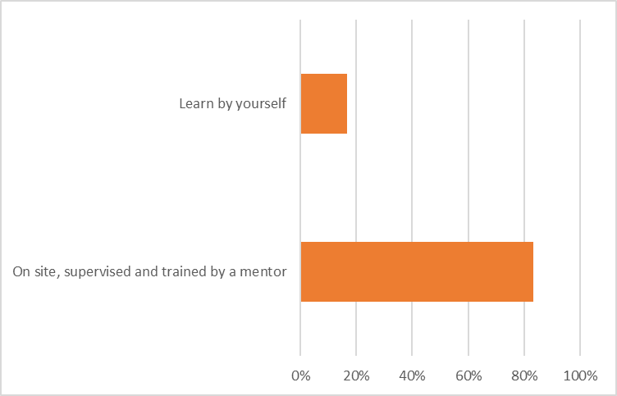
Block 2- Current status, starting point
If not, what kind of additional education do the employees get?

Slide 5
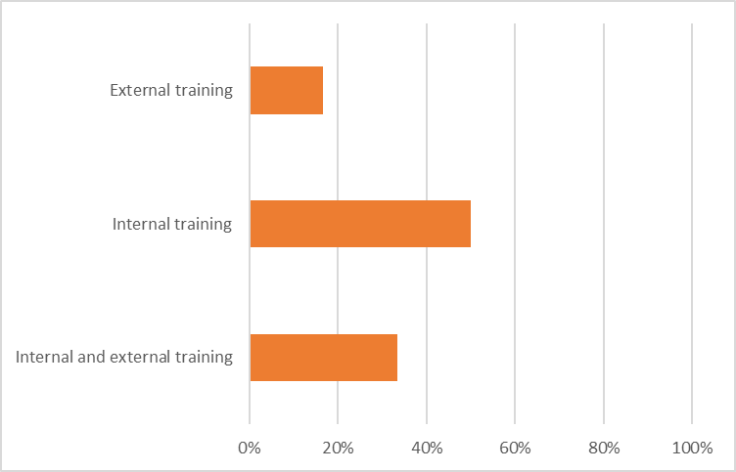
Block 2- Current status, starting point
If your personnel need additional training, do you carry out such training by yourself or do you prefer to get such training by outside sources?

Slide 6
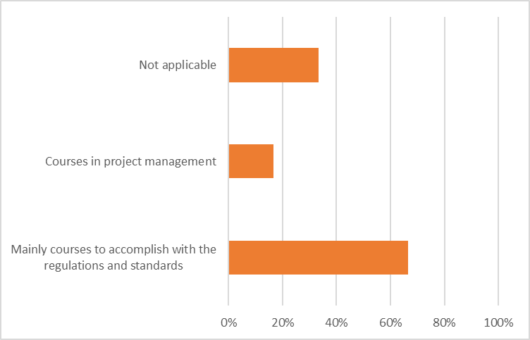
Block 2- Current status, starting point
If the training is conducted in the company:
What type of training is currently being performed at the company?​

Slide 7
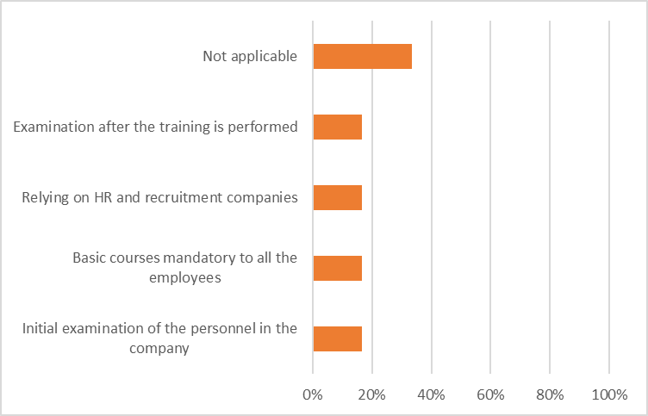
Block 2- Current status, starting point
If the training is conducted in the company:
What type or prerequisites are required for your courses and how do you validate these?​

Slide 8
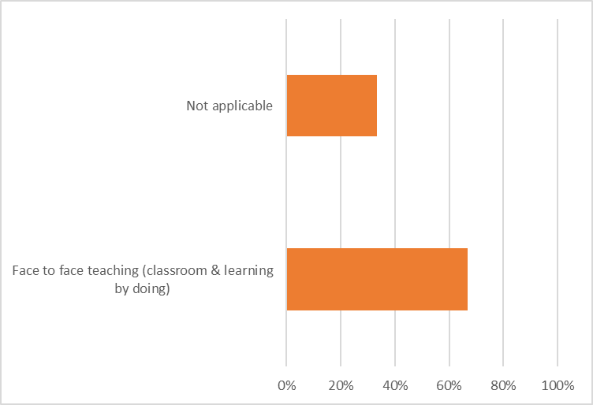
Block 2- Current status, starting point
If the training is conducted in the company:
What type of pedagogy or training methods do you currently apply and why?​

Slide 9
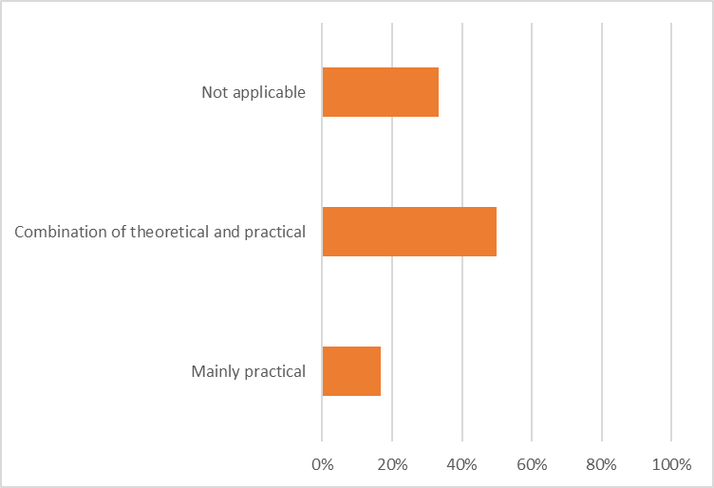
Block 2- Current status, starting point
If the training is conducted in the company:
How is the composition of your courses/training in terms of theory and practice?

Slide 10
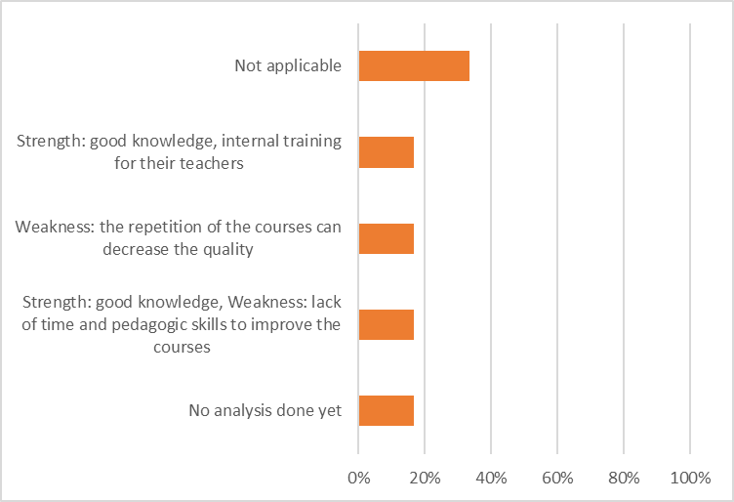
Block 2- Current status, starting point
If the training is conducted in the company:
Have you identified strengths and weaknesses in your training methods? Which ones?

Slide 11
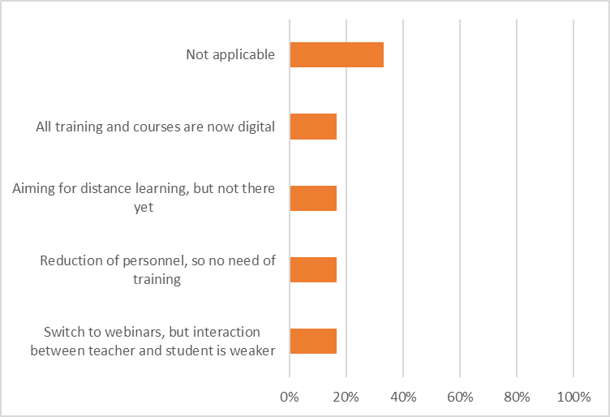
Block 2- Current status, starting point
If the training is conducted in the company:
Has Covid-19 situation forced you to modify/adapt your training methodologies?

Slide 12
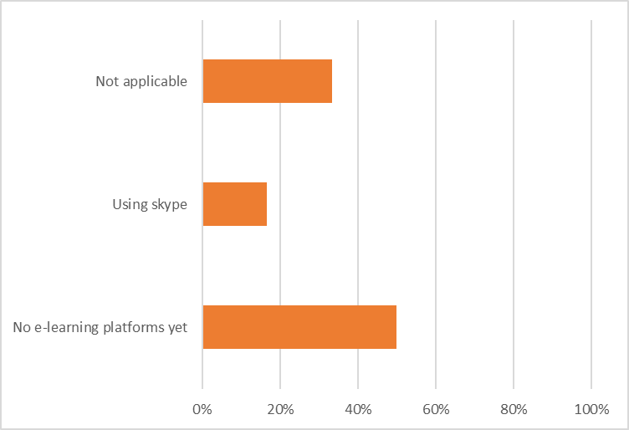
Block 2- Current status, starting point
If the training is conducted in the company:
What type of learning platforms are currently being used in your existing training?​

Slide 13
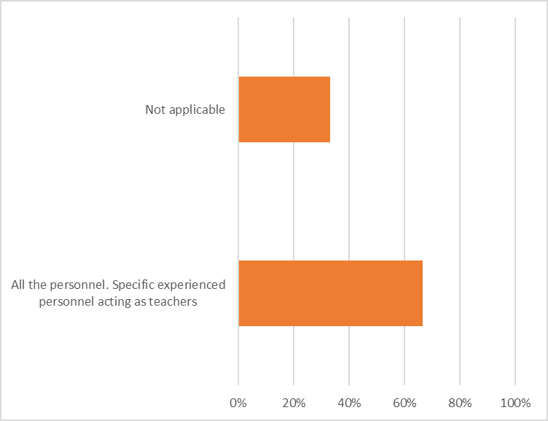
Block 2- Current status, starting point
If the training is conducted in the company:
What type of personnel is involved in training?​

Slide 14
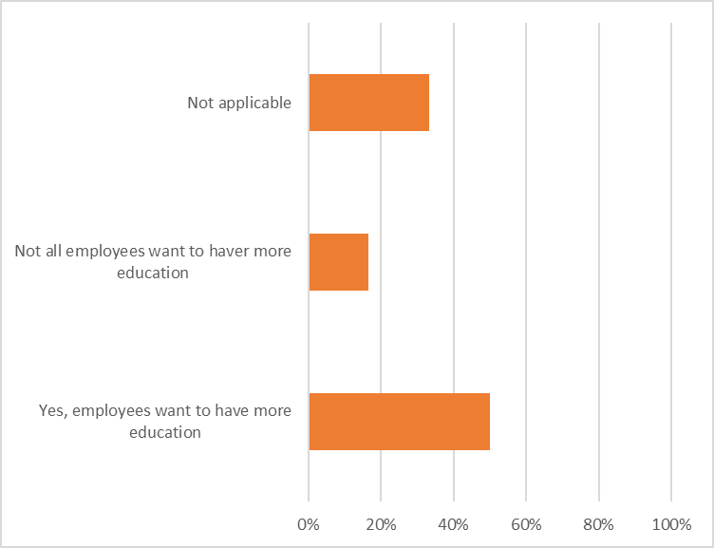
Block 2- Current status, starting point
If the training is conducted in the company:
Do your employees feel they need training (employee’s perception)?​

Slide 15
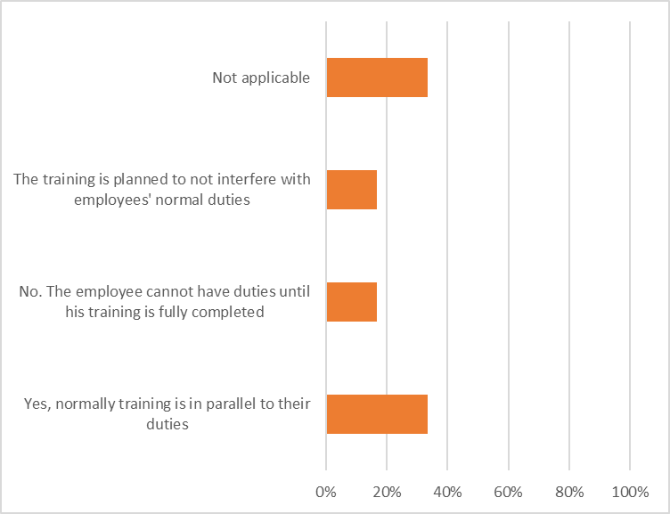
Block 2- Current status, starting point
If the training is conducted in the company:
Do they have to combine their “normal duties” meanwhile taking the training?​

Slide 16
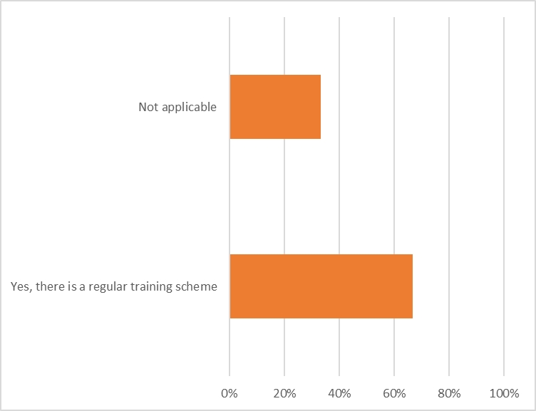
Block 2- Current status, starting point
If the training is conducted in the company:
Do you have a formal/informal on-the -job training scheme?

Slide 17
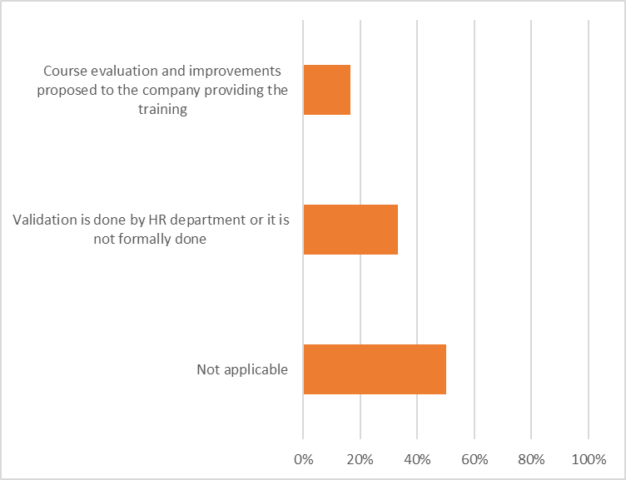
Block 2- Current status, starting point
If the training is carried out outside the company:
How do you assess/validate the learning outcomes and quality of that education/training?

Slide 18
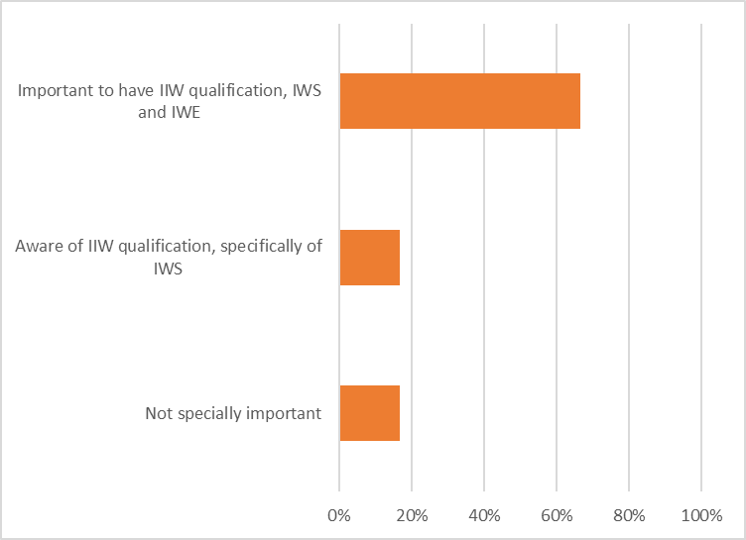
Block 2- Current status, starting point
If the training is carried out outside the company:
Is it important for you that the training/qualification is harmonized? (i.e., EWF, IIW)

Slide 19
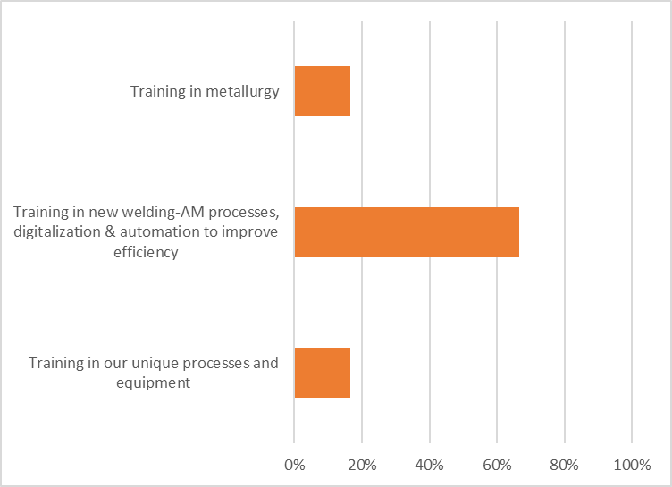
Block 3 – Views on future and improvements
Is there any area where you foresee the need for training in the near future?

Slide 20
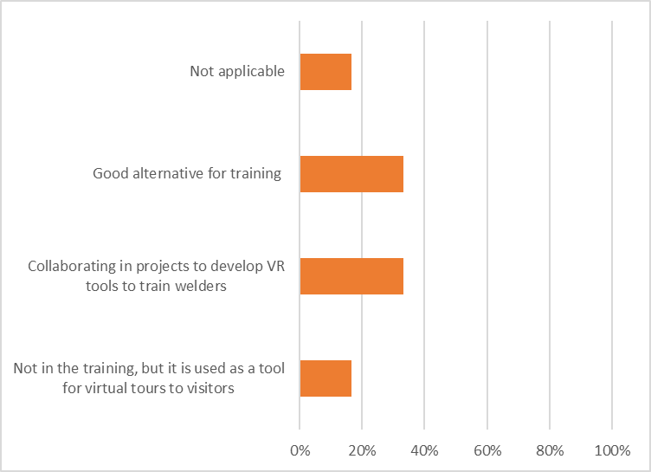
Block 3 – Views on future and improvements
Do you foresee virtual reality as a possible tool for training in your company? Do you have experience with it?

Slide 21
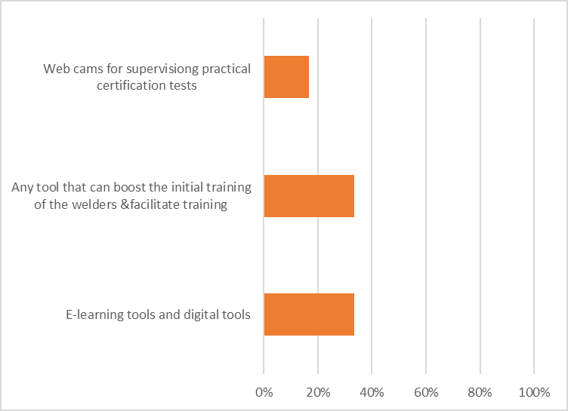
Block 3 – Views on future and improvements
Is there any other tool/platform that you foresee as important for future training?

Slide 22
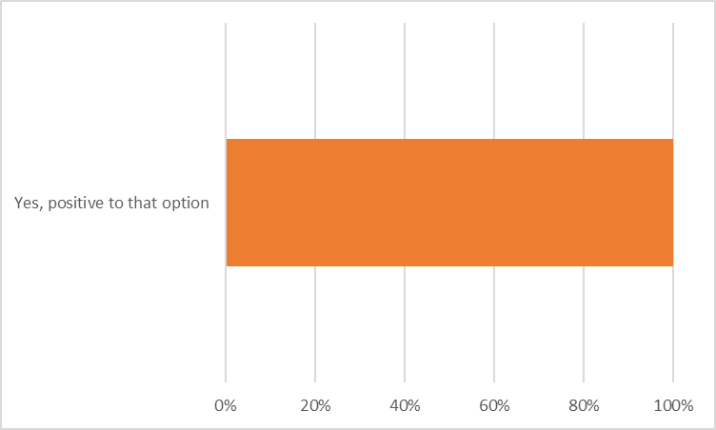
Block 3 – Views on future and improvements
Would you be open to send employees to a pilot course in the framework of this project?

Slide 23
Concluding remarks
Formal education does not give enough background (so VET is needed!)
All the companies have onsite training (given by colleagues with more experience), and only a minority have external training.
Current pedagogic approaches are traditional (practical + some classroom). However, most of them would like to have e-learning platforms (specially motivated by the pandemic), but not all the companies are there yet.
Some other company see VR as a positive tool for their training even though it has limitations, as well as group discussions may be negatively affected.
Important weakness for their internal training is the lack of time for the internal teachers to prepare/improve their courses and their lack of pedagogic skills.
For most of the companies, harmonization in the welding-related education (IIW, EWF) is important.
Current training is basically focused on fulfilling H&S regulations and personnel certifications, but future training wishes are related to automation, digitalization (Industry 4.0) & new welding processes (to boost their efficiency).

