Slide 1
About the survey
26 januari - 21 februari 2024

Slide 2
Purpose
About the study environment
Investigating the study environment of doctoral students.
Part of the quality assurance system for education.
Two-year cycle
News 2024
Externally employed doctoral students participate.
Questions to employed doctoral students: a new section with questions, some adjustments of other questions.
Carreer plans: a new section.

Slide 3
Distribution and response rate
Distribution
Time: 26 January - 21 February 2024, four reminders.
Distribution: digital survey, email.
Response rate
Population: 68 PhD students, 51 internal, 17 external (tredjepartsdoktorand)
Response rate: 60 percent, 41 respondents

Slide 4
Non-response:
Sex/gender
 | PhD students |  | Response |  | Response rate (within group)
 | Number | % | Number | % | %
Female | 44 | 65% | 24 | 62% | 55%
Male | 24 | 35% | 15 | 38% | 63%
Total | 68 | 100% | 39 | 100% | 57%
Internal non-response: 2

Slide 5
Non-response:
Internal/external
 | PhD students |  | Response |  | Response rate (within group)
 | Number | % | Number | % | %
Internal | 51 | 75% | 32 | 78% | 63%
External | 17 | 25% | 9 | 22% | 53%
Total | 68 | 100% | 41 | 100% | 60%

Slide 6
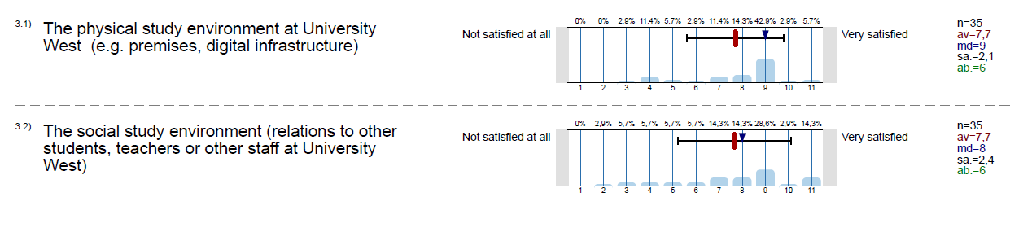
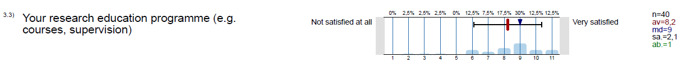
Overall satisfaction
How satisfied are you overall with:
(7,6)
av 2022: 8,1
Averages for internal students in brackets
(7,5)
av 2022: 7,3
(7,8)
av 2022: 7,4
Compared to 2022
Increase in satisfacton with social study environment and research education programme
Decrease in satisfaction with physical infrastructure
Notes:
Se nästa sida för att se hur man lägger till en film.

Slide 7
Main findings
Overall high satisfaction with study environment and research programme
Women are more satisfied with the social study environment and the research education programme than men (average 8,0 to 7,2 and 8,7 to 7,7)
International students are more satisfied with the physical study environment than domestic students (average 9,3 to 7,0)
External students are more satisfied with their research study programme than internal students (average 9,7 to 7,8)
Notes:
Se nästa sida för att se hur man lägger till en film.

Slide 8
Comments:
Physical study environment
Lack of meeting places for doctoral students on campus
“It would be good to have a physical place on campus to meet and interact with other PhD students”
“Co-locate all the PhDs. We need opportunities to meet. As for now, we are self-arranging that.”
Digital infrastructure
Lack of digital support for and knowledge about some software needed for research
Problems with registration for external doctoral students (no access to courses at the start of the program)

Slide 9
Comments:
Social study environment
It has improved with a director of studies, arranges workshops with doctoral students
Some students express a lack of community at HV (esp. international and externally employed students)
“More inclusiveness for the international community. Loneliness is a disease”
“International students are left isolated because of cultural clashes, norms, and the failure of the system to empathize with them.”
“It's enough. However, I feel isolated socially; perhaps it will be better in time.”

Slide 10
Comments:
Research programme
Improve introduction to research studies, including information about support for doctoral students
Too much reporting about what you do, takes time from studies and performing research (e.g. ISP)
“As a PhD student there is far too much time spent reporting the status of things than actually working on technical subjects, learning how to communicate them and improve.”
Common structures
“More guidelines, structures and routines, that all supervisors and involved positions are up to date and agree on! “

Slide 11
Comments:
Research programme
Opinions about courses : both praise and critique.
“I myself feel that /…/ we at University West study more courses than they do at other institutions of higher learning”.
“more attention should be paid to enhance the PHD courses and align them with the needed skills for research, publication, proposal writing, etc.”

Slide 12
Support of doctoral students

Slide 13
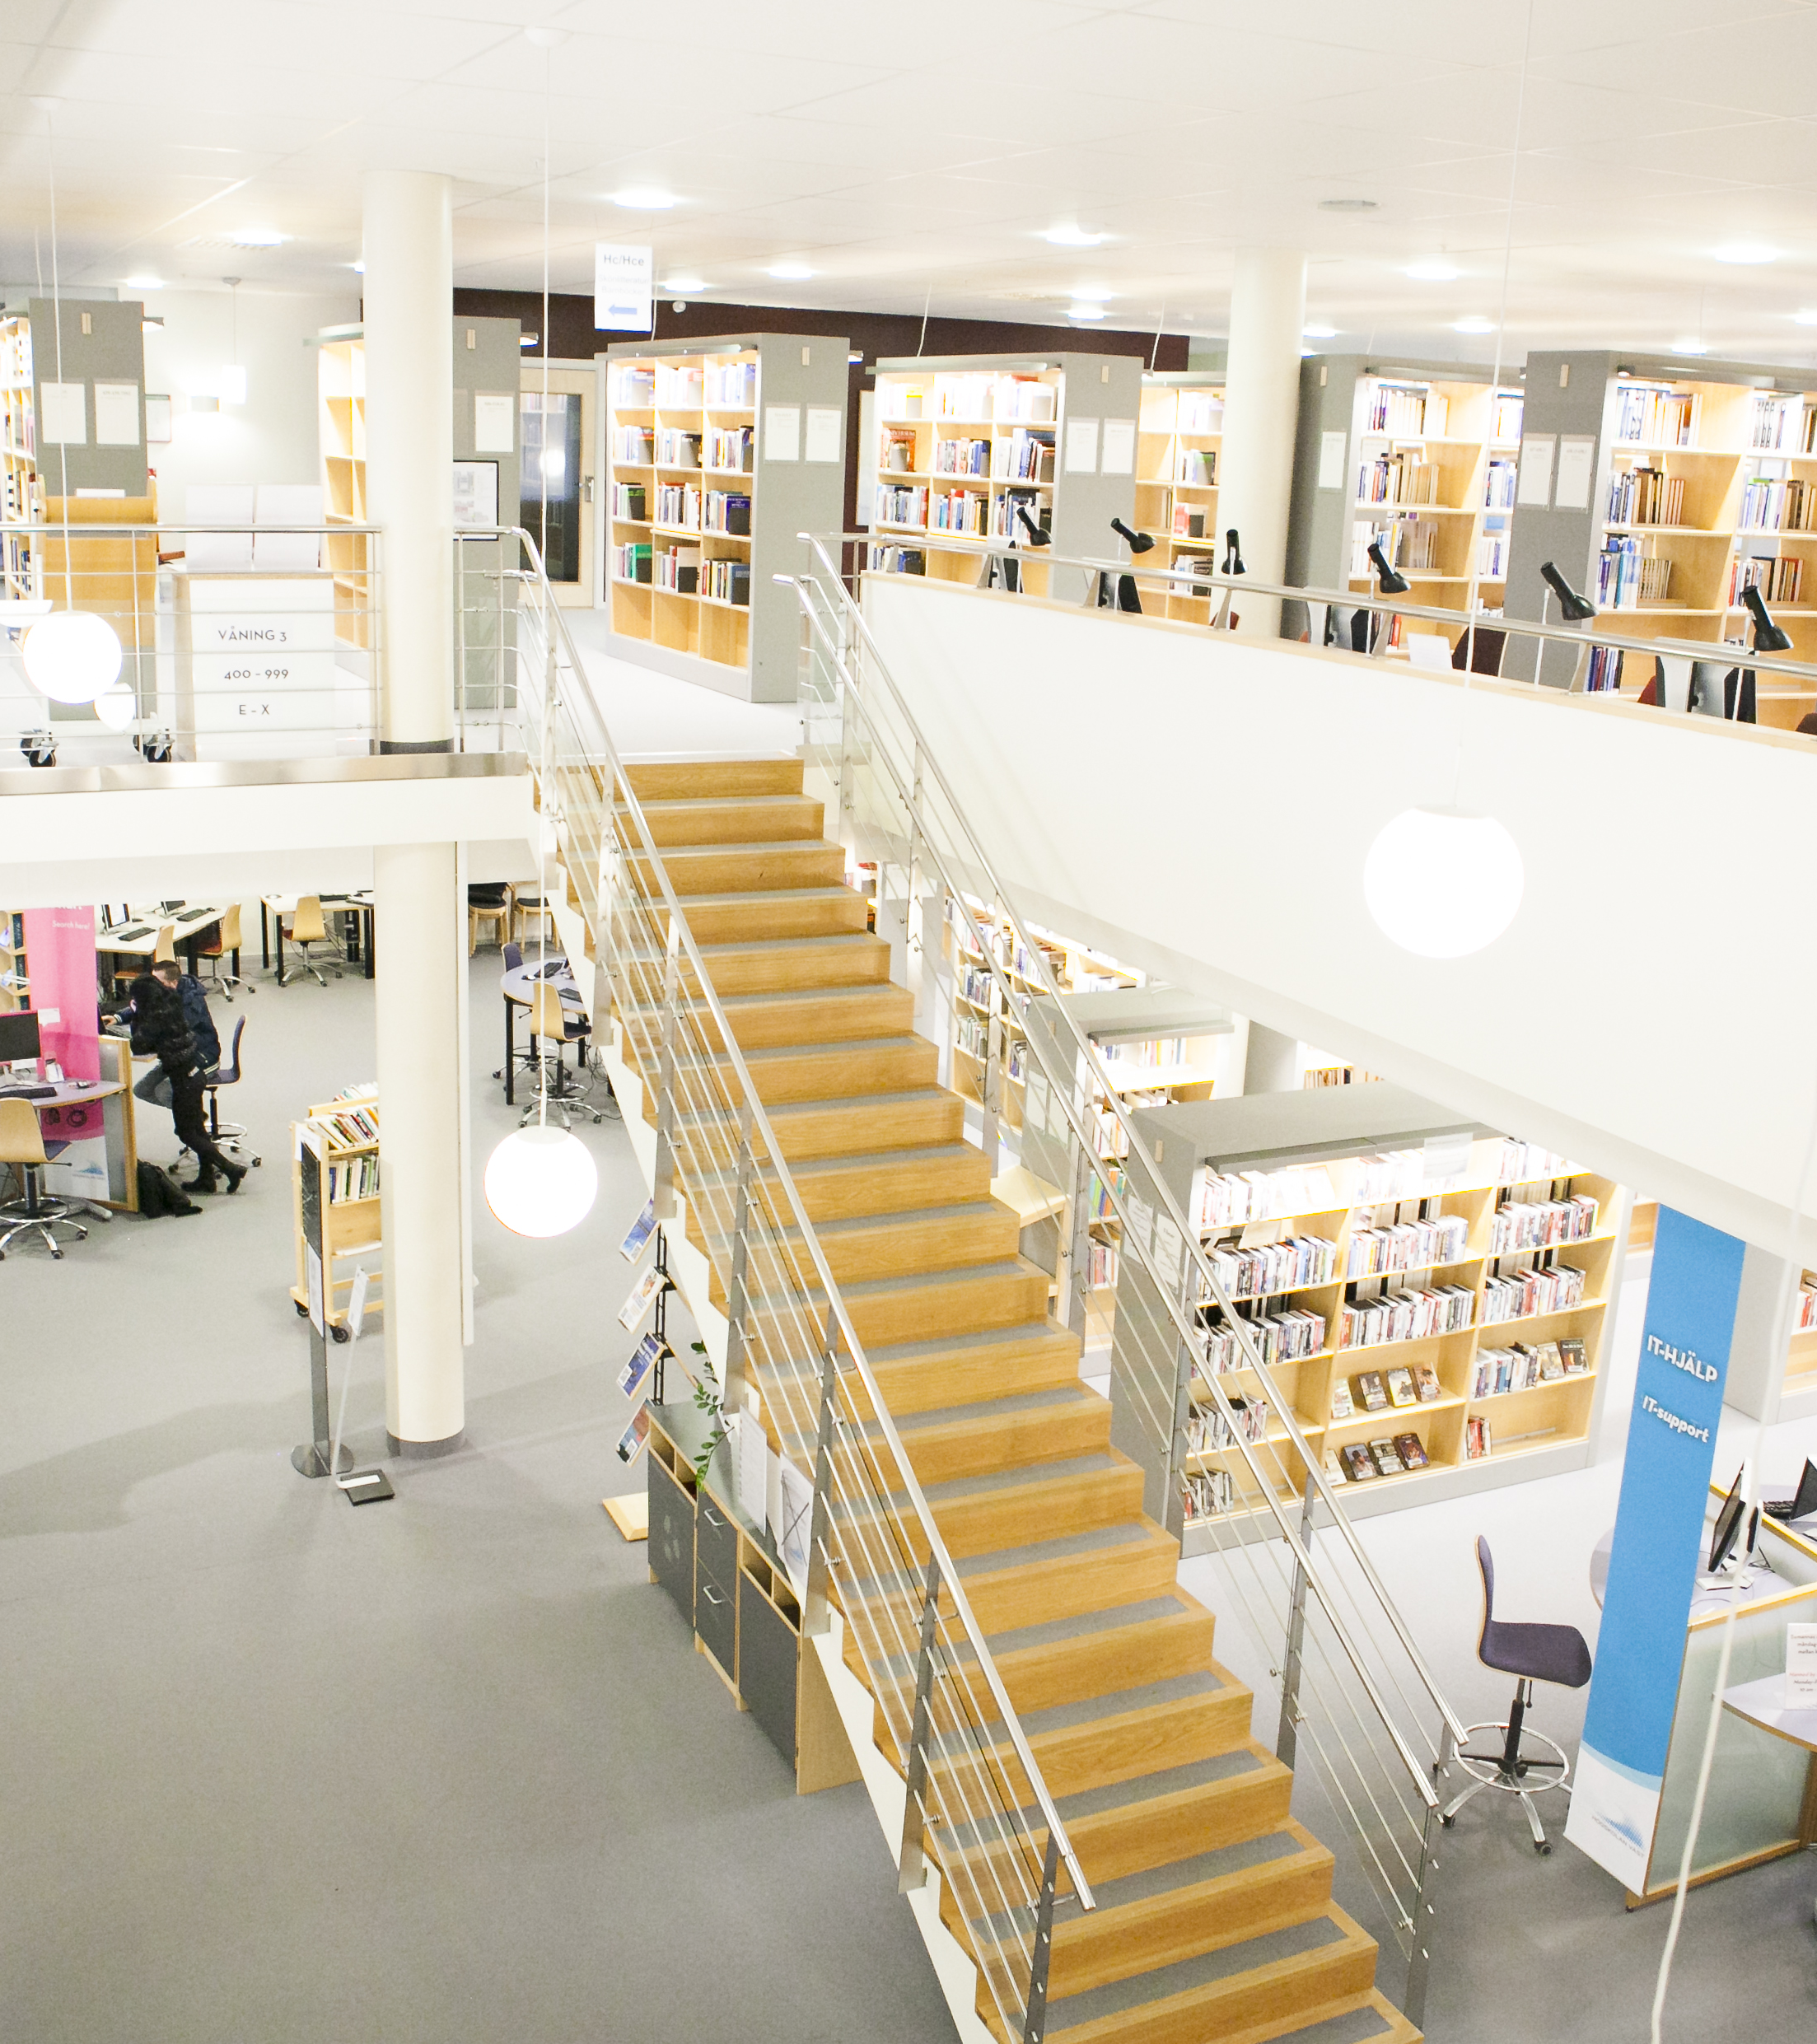

Main findings
Similar pattern as 2022 except for the Student Union
Most satisfied with work office (3,8) and library services (4,3)
Least satisfied with Health Care services (2,6 few answers) and Study – and career counselling (2,8)
Satisfaction with Student Union has decreased most (from 3,9 to 3,2)
Women less satisfied than men
International students more satisfied than domestic

Slide 14
Text comments
Lack of knowledge about some of the support functions (e.g. GIO and Study- and career counselling)
Digital infrastructure: Works well for general things - but lack of support and competence about software needed for research.
“Concerning the digital support and university's supply on programs that are necessary for research studies, it is limited.”
“To be advised to use free software to transcribe sensitive research is, to put it mildly, outrageous”

Slide 15
Study situation

Slide 16
Main findings
Similar pattern as 2022.
Results indicates that the study situation is good for most students, but that there are students who experience problems.
There is most disagreement about funding and guidance/advice concerning future career options. 28 percent do not think they have enough funding for activities, and 31 percent do not think they get guidance about future career options.
Notes:
Se nästa sida för att se hur man lägger till en film.

Slide 17
Group differences
Women to a lesser extent feel as a part of a research group and to a lesser extent think that they receive guidance concerning future career options, but they are more positive to the social climate in the programme than men.
International students feel more as part of a community in their research study programme and research group.
External doctoral students experience more conflict between their doctoral studies and private life, but at the same time to a higher extent see their total workload as reasonable.
Notes:
Se nästa sida för att se hur man lägger till en film.

Slide 18
Text comments
Funding for activities
Scarce at the end of studies
Inequalities between students in funded research projects and students with their own PhD-project.
Work balance
Students describe how they try to balance between work/studies and private life.
One student describes norms about research as a vocation which needs all attention, day and night.

Slide 19
Departmental duties

Slide 20
Departmental duties (DP)- Main findings
2024
81 percent with duties (among internal students)
100 percent teach
2022
91 percent with duties
87 percent teach
Same pattern as 2022, but lower averages
A large majority of the internal students report DP (but less so than 2022)
Mainly prospective benefits: 71 percent think DP will benefit their future careers (85 percent 2022)
25 percent think DP have benefitted their thesis project (45 percent 2022)
54 percent are content with the support they have received (70 percent 2022)

Slide 21
Text comments
Complaints about managers who treat students unequally in relation to DP (4 comments)
Appreciation for support received from management (1 comment).
Time conflict between DP and research (3 comments).
Weak connection between research and teaching when it comes to content (1 comment).

Slide 22
External employment
New section 2024

Slide 23
External employment - Main findings
22 percent are externally employed.
The externally employed doctoral students to a very high extent agree that:
a) agreements are generally kept (88 percent)
b) their work contribute to their dissertation (67 percent)
c) that their doctoral studies will benefit their future career (100 percent)
External students see more synergies between their work and the progress of their dissertation than internal students see between departmental duties and their dissertation.
Notes:
Se nästa sida för att se hur man lägger till en film.

Slide 24
External employment:
Text comments
Complaints about the registration process for externally employed students.
Lack of knowledge about support offered to doctoral students.
Stress connected to conflict between research and regular work tasks.
Low sense of community with fellow doctoral students.
“As a third-party doctoral student, it is hard to feel 'at home' and as part in the programme. You are in some kind of limbo, not as an employee and not as a student. Some kind of a student with more benefits than a regular student.”
.

Slide 25
Equal terms

Slide 26
Main findings
Lower response rate on these questions (between 22 to 32 students)
27 percent (or 6 students) do not think that all students get the same opportunities regardless of background (gender, transgender identity or expression, ethnicity, religion or other belief, disability, sexual orientation, age). Increase compared to 2022.
Quite high trust in how University West works with the issues and that teachers and staff will act if they become aware of offensive and/or discriminatory treatment (3,8 and 3,9 average, scale 1-5) (4 students answer 1 och 2)
Text comment about a student who was very criticized by a teacher with other students and teachers present, and that the student did not get adequate support afterwards.
Notes:
Se nästa sida för att se hur man lägger till en film.

Slide 27
Group differences
Women to lesser extent than men find that University West is working actively to prevent offensive and discriminatory treatment in their research education programme (0,8 difference in average)
International students and externally employed students have higher trust than domestic and internal students in the work of University West and to a higher degree trust that teachers and staff will act if they become aware of offensive and/or discriminatory treatment.
Notes:
Se nästa sida för att se hur man lägger till en film.

Slide 28
Studies and health

Slide 29
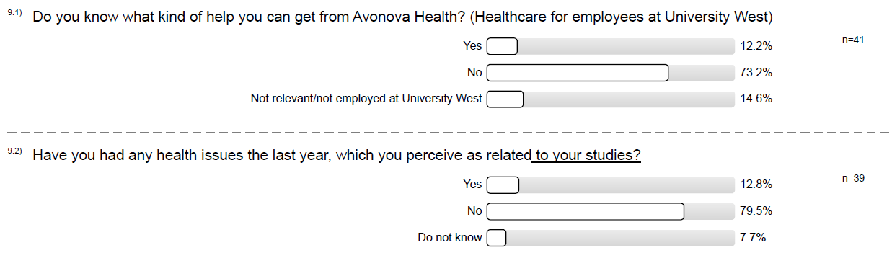
Health - main findings
Notes:
Se nästa sida för att se hur man lägger till en film.

Slide 30
Health - main findings
Knowledge of services
Low knowledge about Avonova Health (12 percent compared to 33 percent 2022, 14 percent if “not relevant” answers are excluded)
Health issues
13 percent report having health issues related to their studies (similar to 2022), whereof all are women (18 percent of women compared to none of the men).
Written comments: few, about information issues (lack of).
Notes:
Se nästa sida för att se hur man lägger till en film.

Slide 31
Participation and influence

Slide 32
Participation - Main findings
Similar results as 2022, except for how the Student Union works with doctoral students’ issues (decrease from 3,3 to 2,8)
External and international students are overall more satisfied with their possibilities to participate and influence different aspects of their studies.
Notes:
Se nästa sida för att se hur man lägger till en film.

Slide 33
Text comments
“I think, overall, it is easier to convey issues as a PhD student now since we have a study director with whom we have regular meetings.”
“We currently do not have a Student Union that works with research education issues because no PhD student felt that they had the time to manage this assignment.”

Slide 34
Career plans

Slide 35
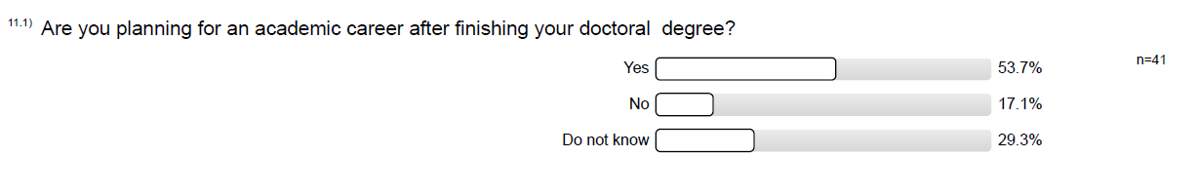
Career plans - Main findings
A majority of students wants a future career within academia
Almost a third do not know.
Notes:
Se nästa sida för att se hur man lägger till en film.

Slide 36
Group differences
Are you planning for an academic career after finishing your doctoral degree?
Student group | Yes | No | Do not know | Total % | Total n
Women | 54% | 17% | 29% | 100% | 24
Men | 60% | 13% | 27% | 100% | 15
International | 50% | 20% | 30% | 100% | 10
Domestic | 57% | 13% | 30% | 100% | 30
External | 22% | 22% | 56% | 100% | 9
Internal | 62% | 16% | 22% | 100% | 32
Notes:
Se nästa sida för att se hur man lägger till en film.

Slide 37
Text comments
Improve support for career planning
Stressful for international students
“It is very stressful to international PhD students, so I just do my best to apply for a job or search for a postdoc if any university opens at the right time I graduate.”
“the future career makes international PhD students more stressed than the PhD itself. Since we have the visa pressure from Migration”.

