Slide 1
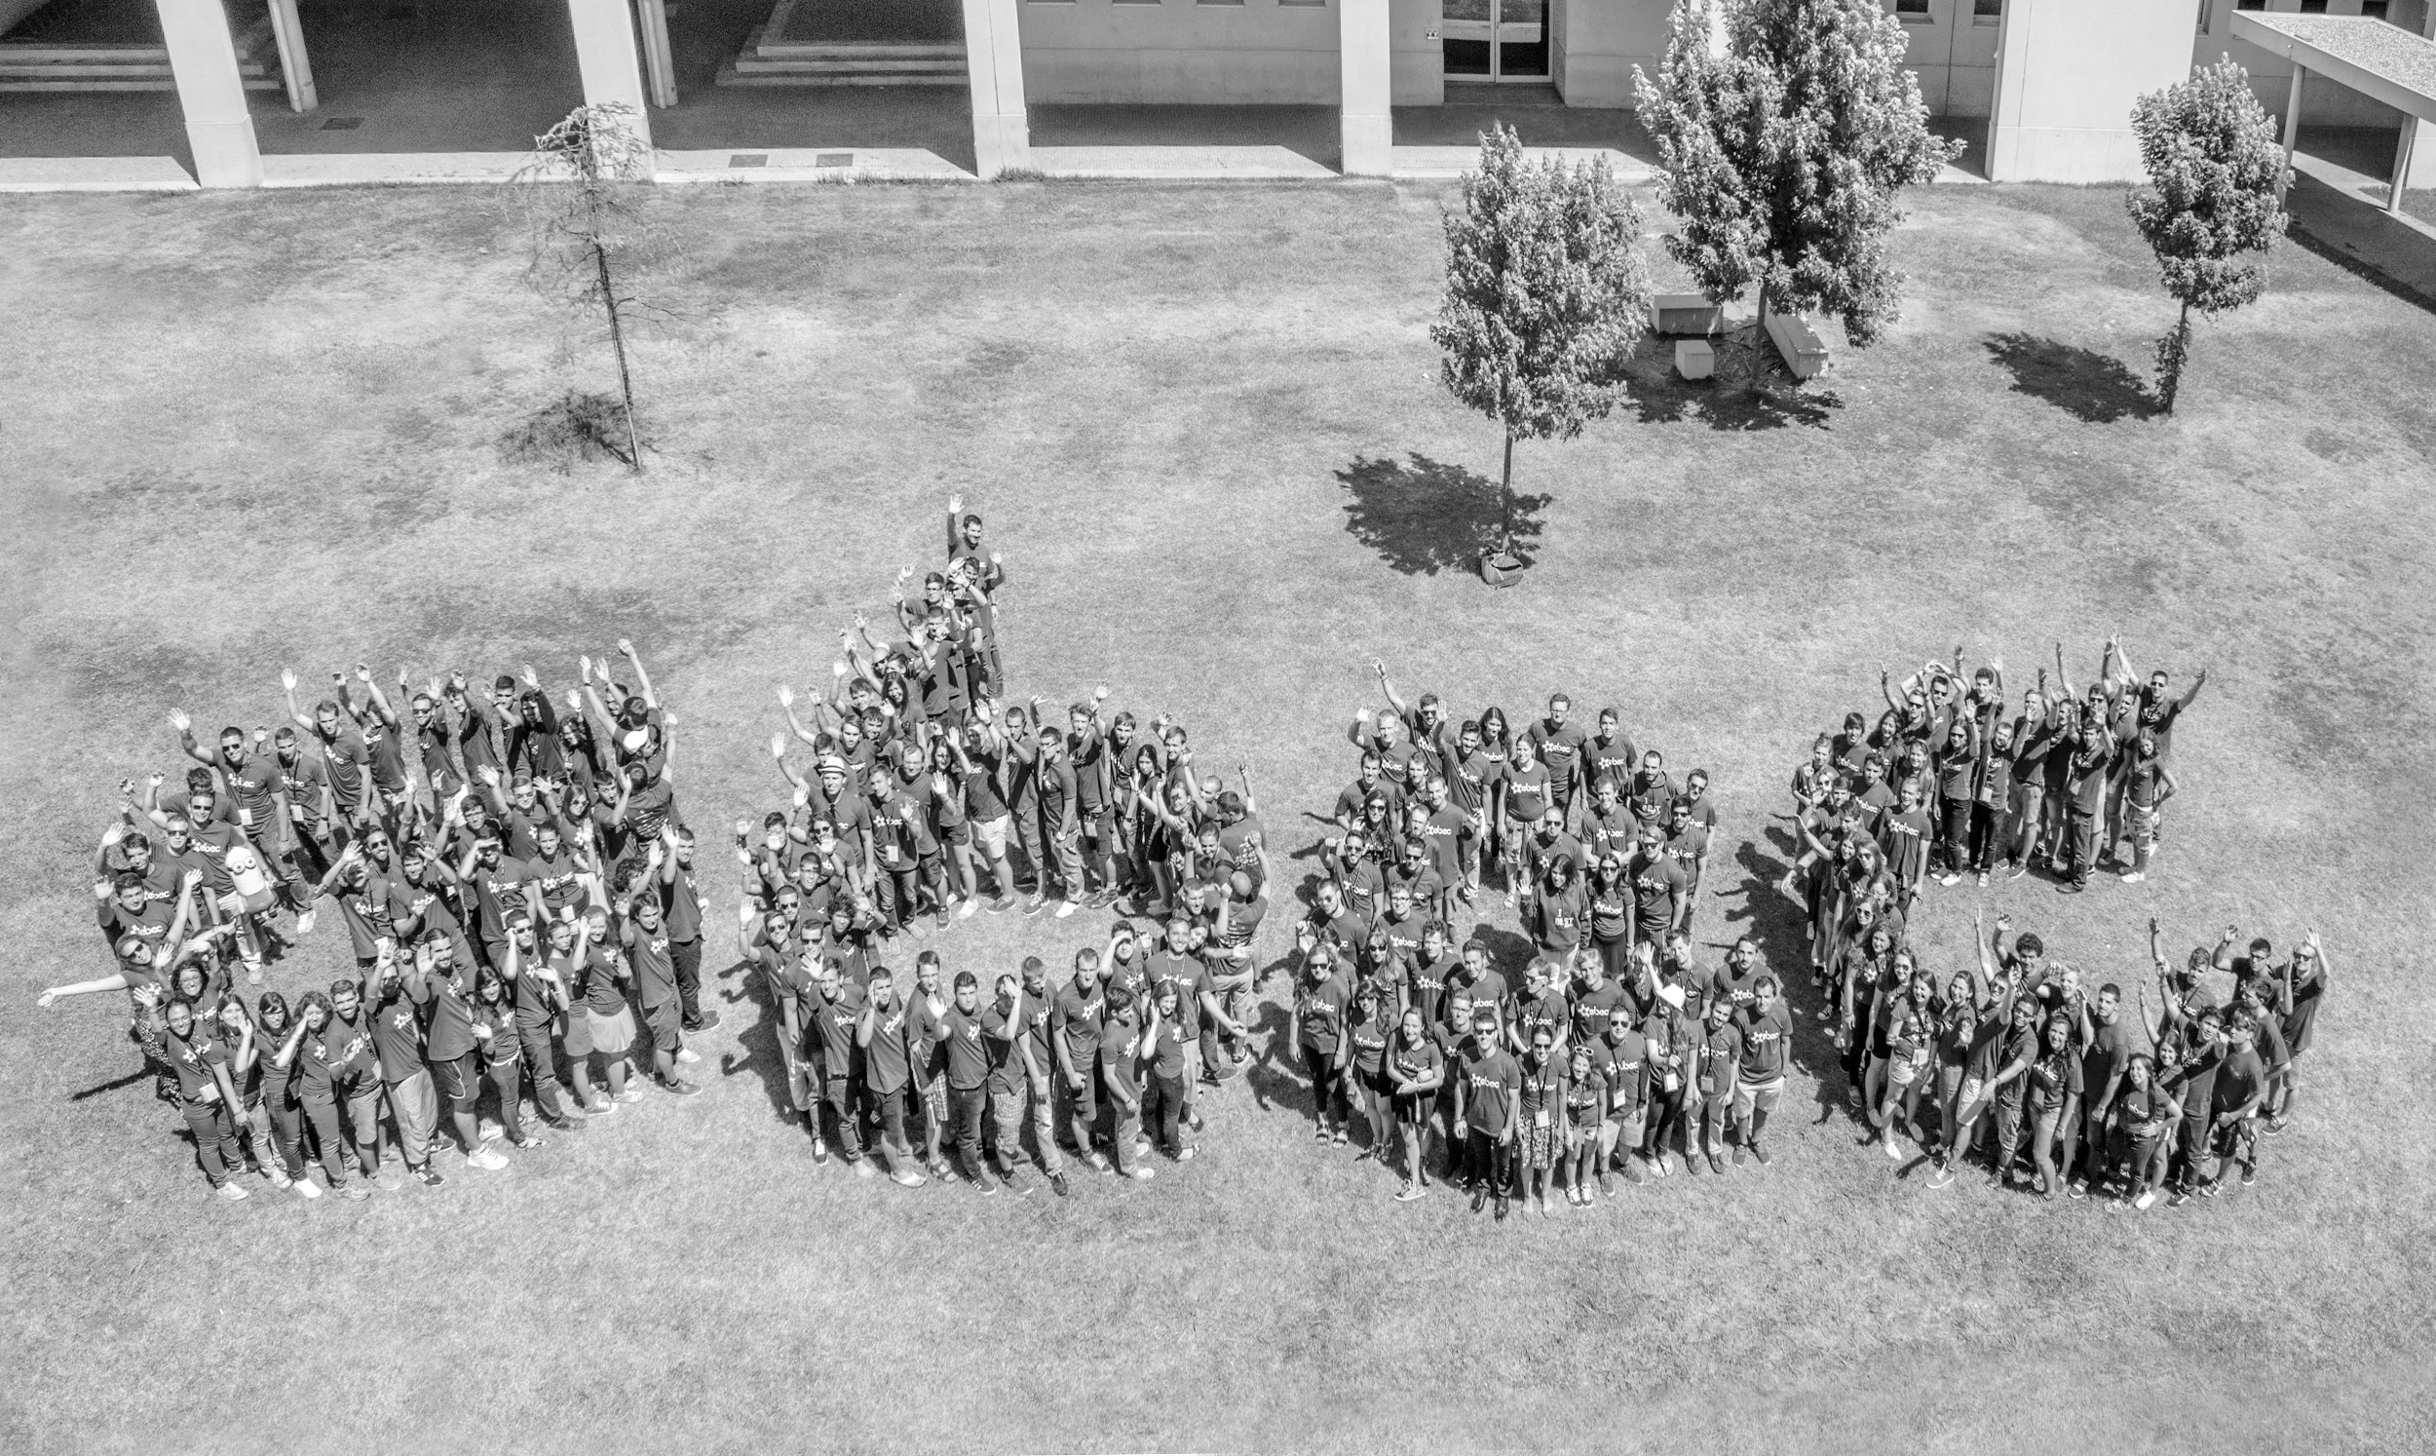
EBEC bridges University-Business Skills
Andreia Almeida¹, Mariana Masteling¹, Mariana Sousa¹, Marta Cortesão¹, Rita Faria¹
¹Board of European Students of Technology (BEST), BEST Porto, University of Porto

Slide 2
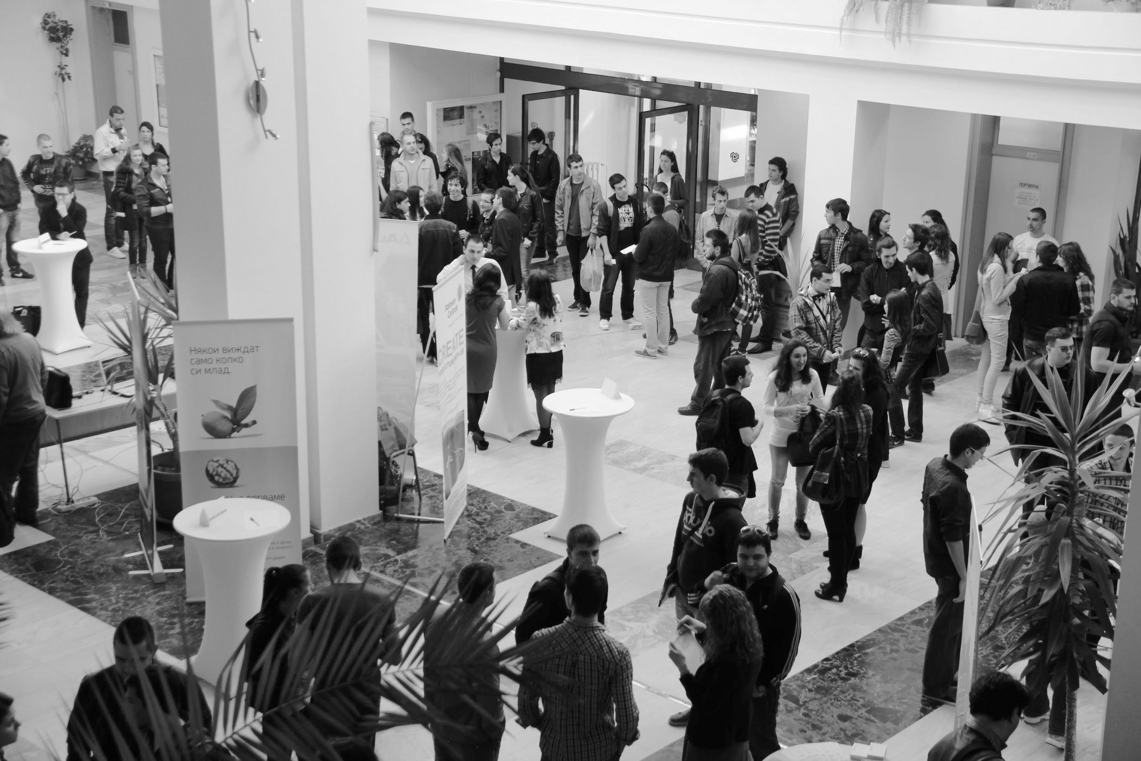
From UNIVERSITY to the JOB WORLD
Technical skills
Theory knowledge
Professional skills

Slide 3
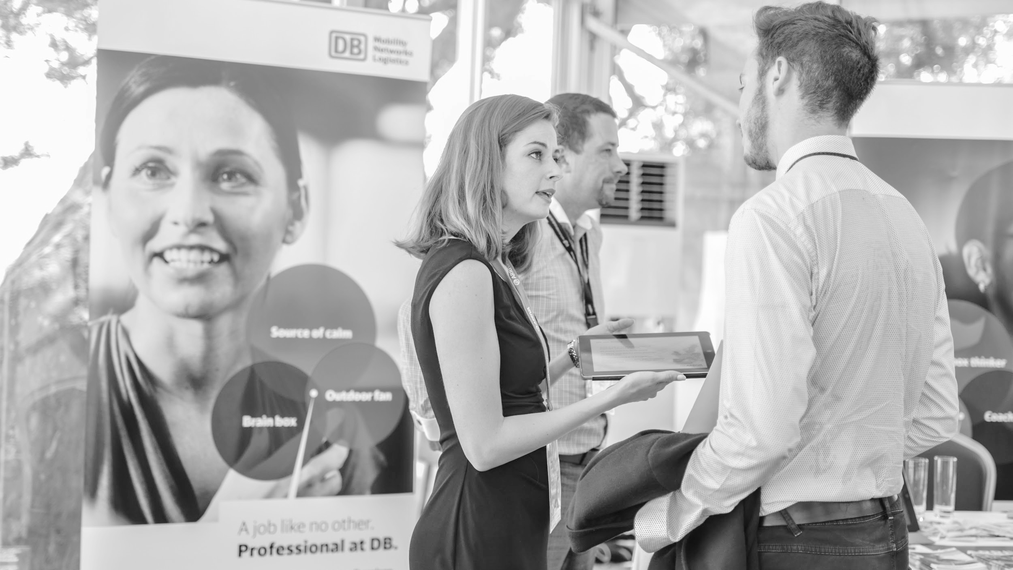
University-
Business Cooperation

Slide 4
STAKEHOLDERS OF HIGHER EDUCATION
University
Business
Students

Slide 5
BEST - BOARD OF EUROPEAN STUDENTS OF TECHNOLOGY

Slide 6
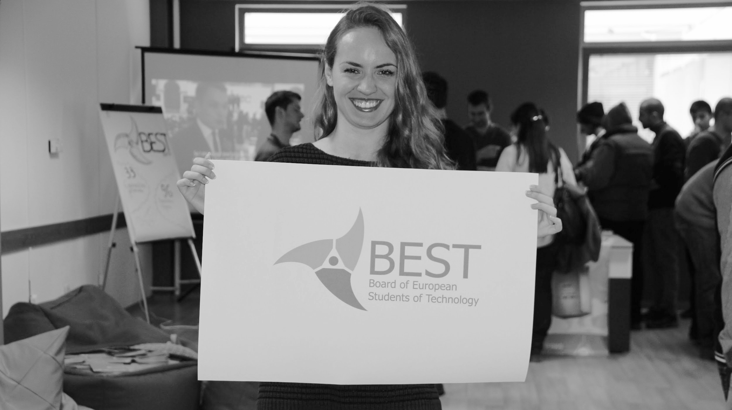
SERVICES OF BEST
Career Support
Complementary Education
Educational Involvement

Slide 7
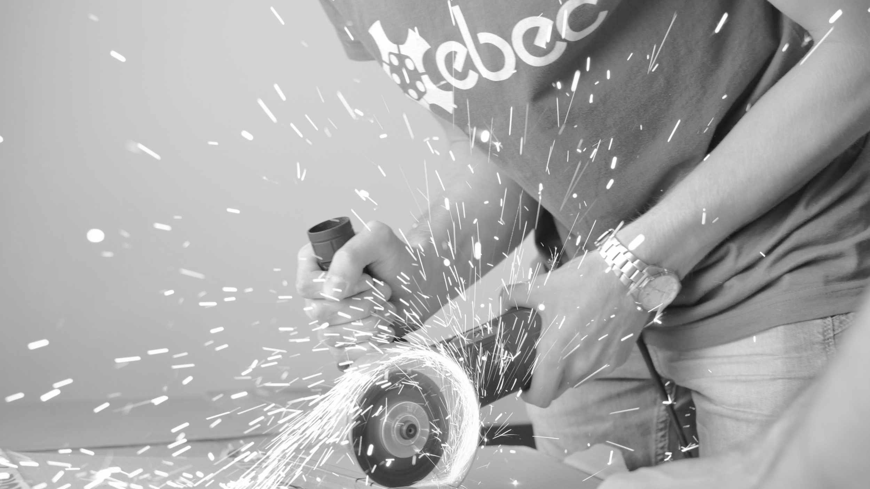
EBEC - EUROPEAN BEST ENGINEERING COMPETITION
1 EBEC final
15 National/
Regional Rounds
83 Local Rounds

Slide 8
EBEC - EUROPEAN BEST ENGINEERING COMPETITION
Team Design
TD
Case Study
CS

Slide 9
EBEC PROJECT 2015
6000
Participants
88
Universities
32
Countries

Slide 10
EBEC Porto
local round
for 8 years

Slide 11
24h
Competition
240
Participants
50
Organisers

Slide 12
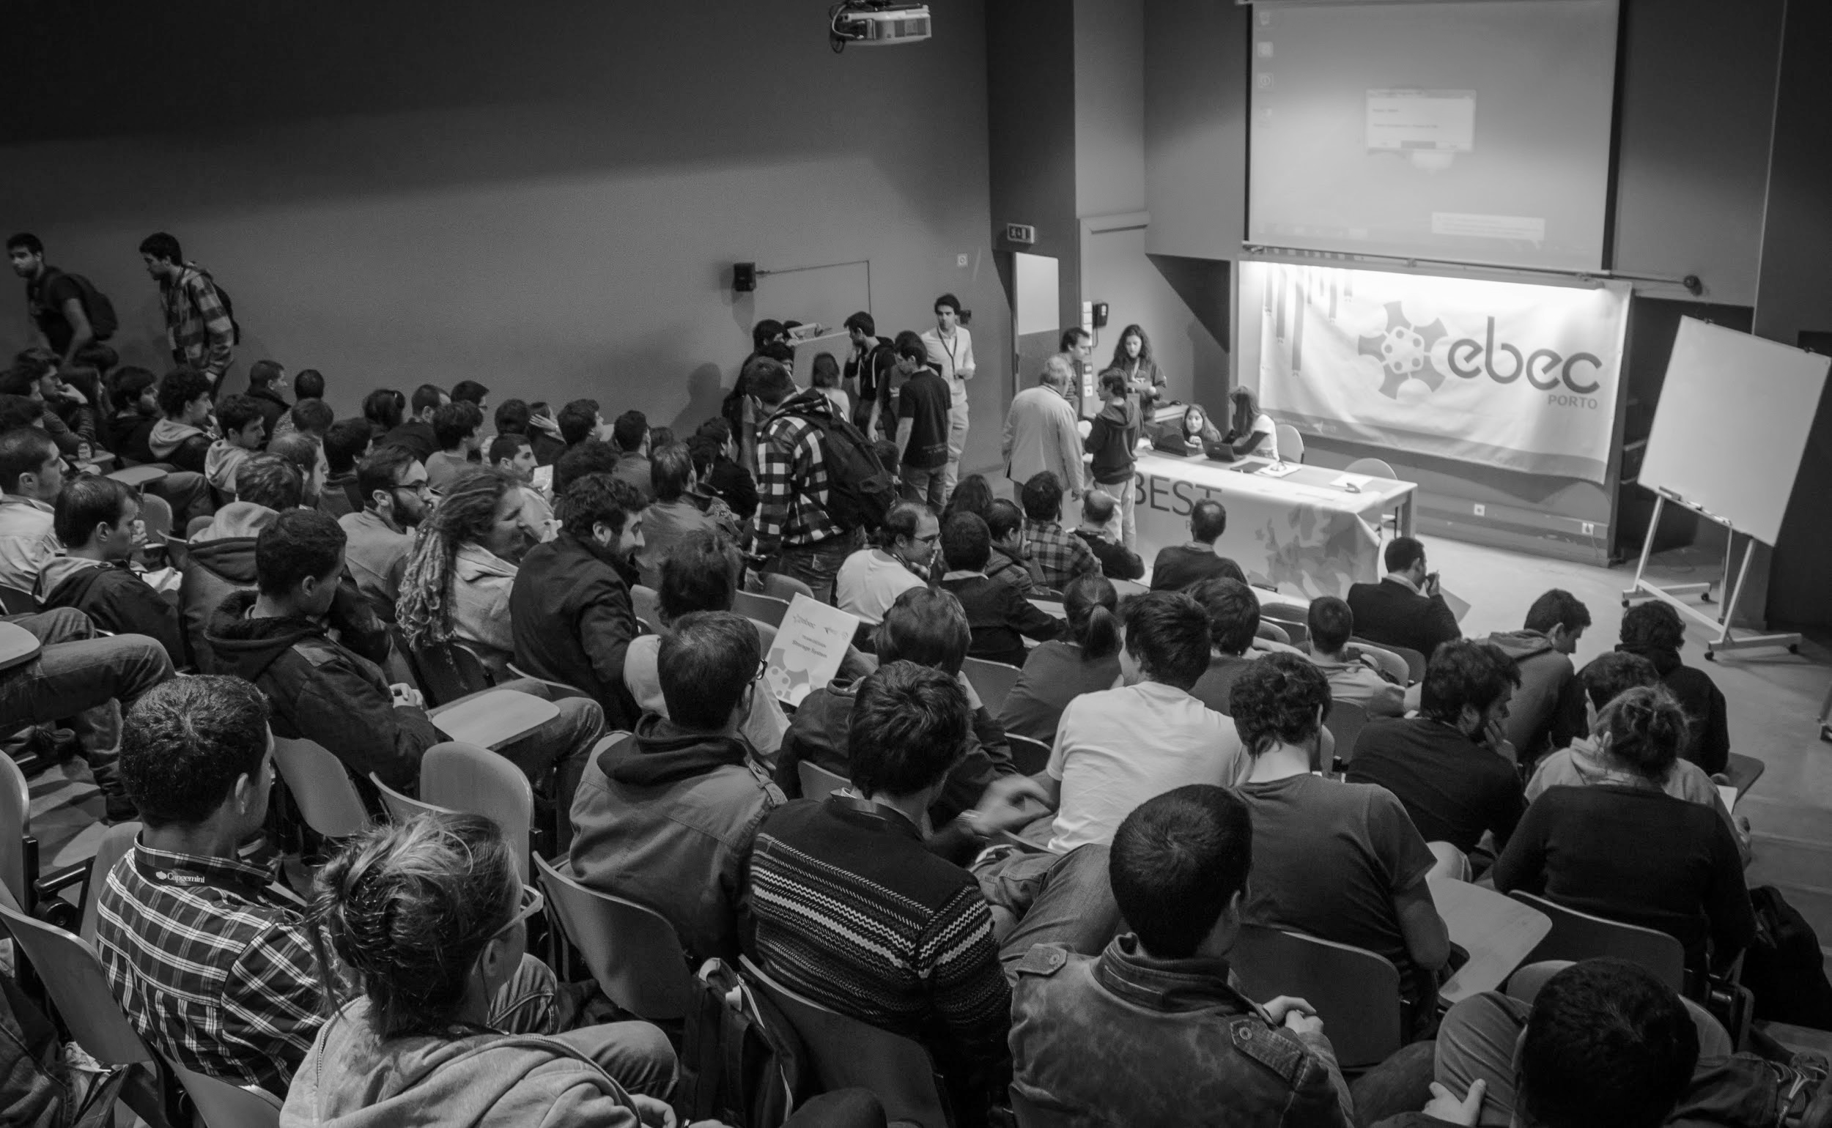
In 2014 EBEC Porto is recognized as a forming unit by the rectorate of the University of Porto
1.5 ECTS*
Participants
2 ECTS
Organisers
* European Credit Transfer and Accumulation System

Slide 13
What makes EBEC so special?
An educational point of view

Slide 14
General EBEC Workflow - How is Local Round organized in Porto Survey to organizers from Porto - What skills are developed? - Are these skills important for a future job application?

Slide 15
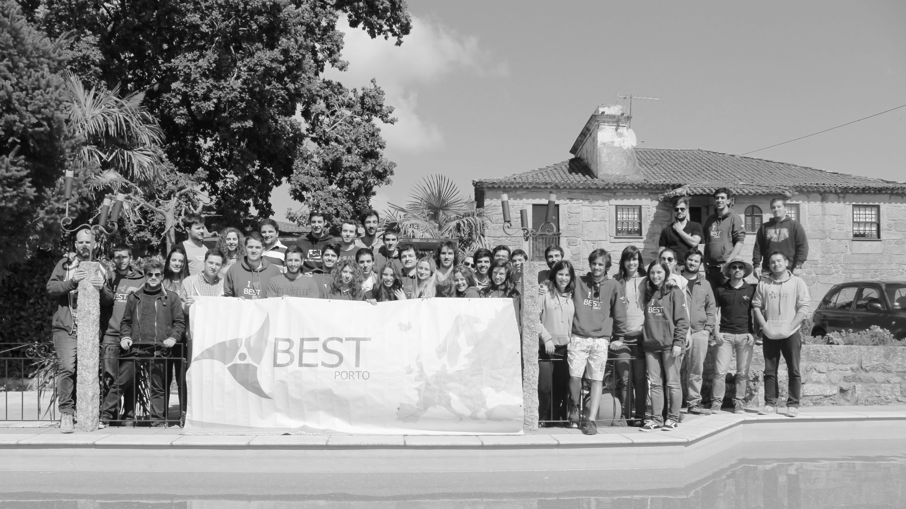
SURVEY
Developed skills by BEST Porto members

Slide 16
EBEC ORGANIZATIONAL WORKFLOW
Team Dynamics
Competition Design
Create the Team
Define Responsibilities
Provide Training
Delegation
Communication Meetings
Preparation of Booklet
Partnerships-Companies
TD-CS topic design
Logistics/Materials
Testing Competition
Rules and Evaluation
Juri
Feedback
Knowledge Transfer

Slide 17
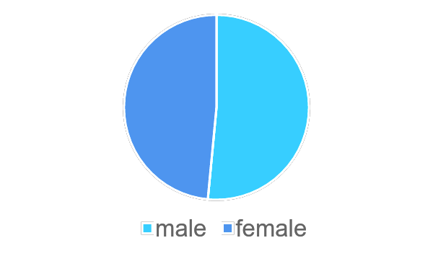
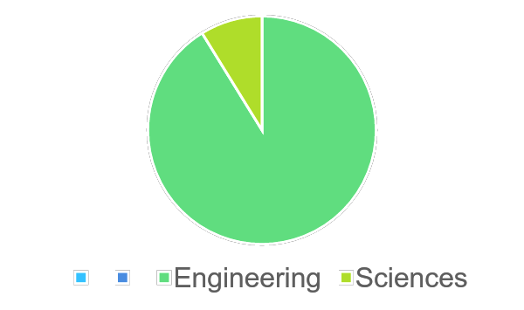
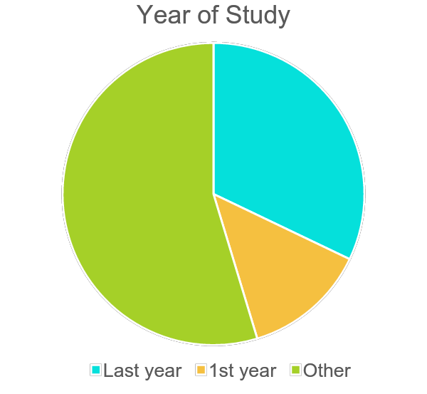
Results: Developed Skills
Survey to BEST Porto members
Total of respondents: 68 | Age: 18-24 |
Respondents Gender
Study field
Year of Study
8,8%
48,5%
25%
51,5%
91,2%
10,3%

Slide 18
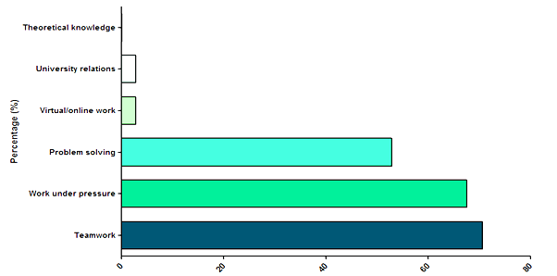
Results: Developed Skills
5 more important skills you develop as EBEC organizer?

Slide 19
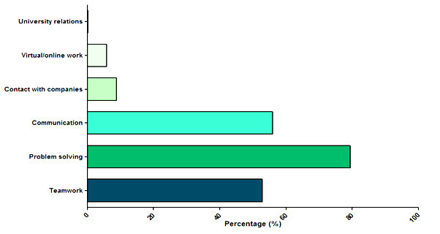
Results: Developed Skills
Skills you think employers/funders find the most relevant when hiring you?

Slide 20
Build a device able to launch an autonomous underwater vehicle (AUV) in the water, remove it from there and place it in the starting place.
Evaluate the impact of the substitution of components used by Sakthi Portugal for the automotive industry
Innovative product ideas that use gas assisted polymer injection processes
COMPANIES INVOLVEMENT - EBEC Porto 2016
Team Design
Case Study

Slide 21
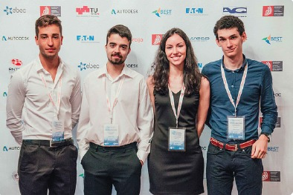
Present the project to ErgoStat’s CEO
Winners of EBEC European final
BRINGING STUDENTS’ CLOSER TO COMPANIES
Case Study - ErgoStat

Slide 22
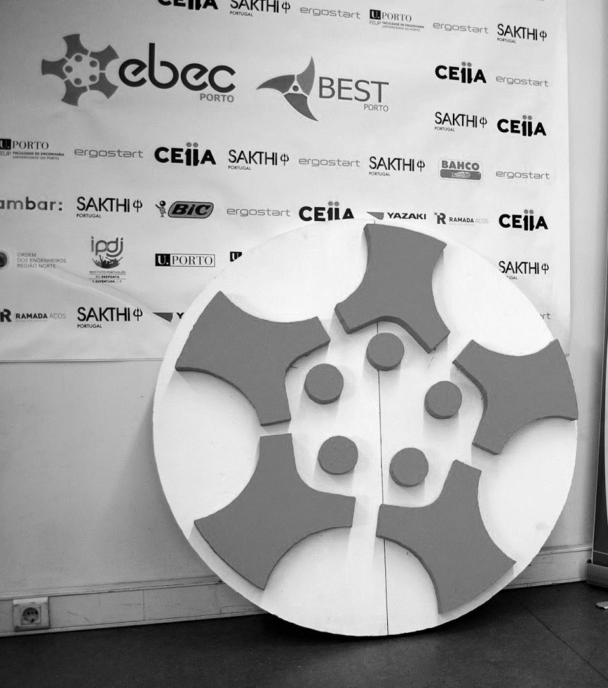
CONCLUSION
EBEC develops professional skills - better prepared students → future employees w/ role in UBC
Companies involvement is crucial for professional development
UP recognizes UBC importance

Slide 23
Thank you!
Any questions?
You can find us at:
porto-paperteam@bestporto.org
Or me at:
marta.cortesao@bestporto.org
https://www.youtube.com/watch?v=vlijNN4Gei8

